Slide 1
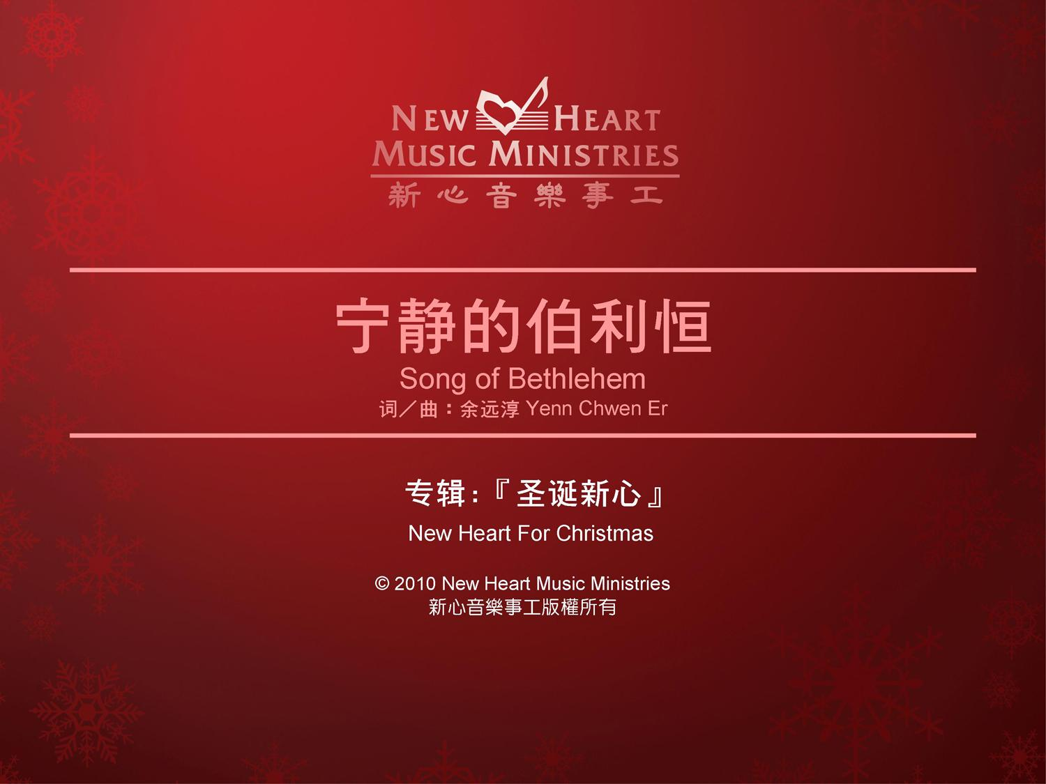

Slide 2

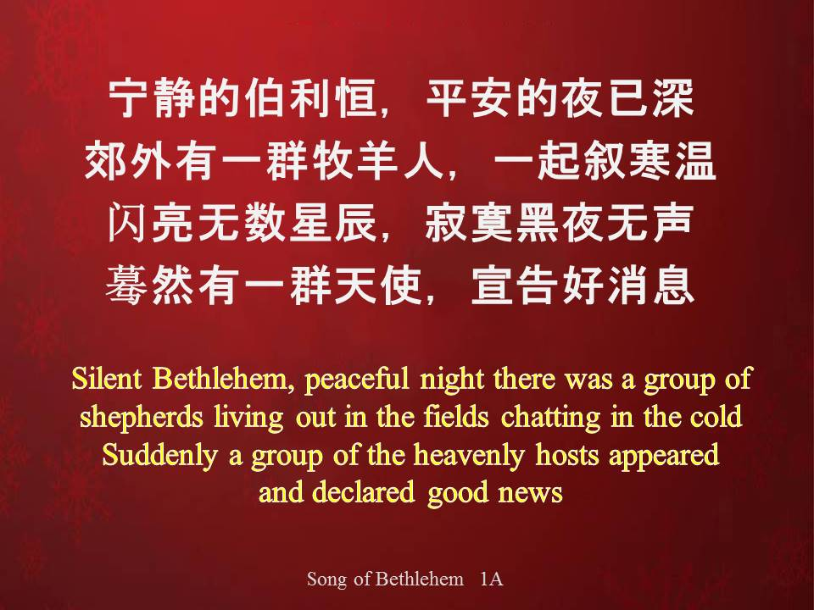
宁静的伯利恒，平安的夜已深
郊外有一群牧羊人，一起叙寒温闪亮无数星辰，寂寞黑夜无声
蓦然有一群天使，宣告好消息
Silent Bethlehem, peaceful night there was a group of
shepherds living out in the fields chatting in the cold
Suddenly a group of the heavenly hosts appeared
and declared good news
Song of Bethlehem 1A

Slide 3
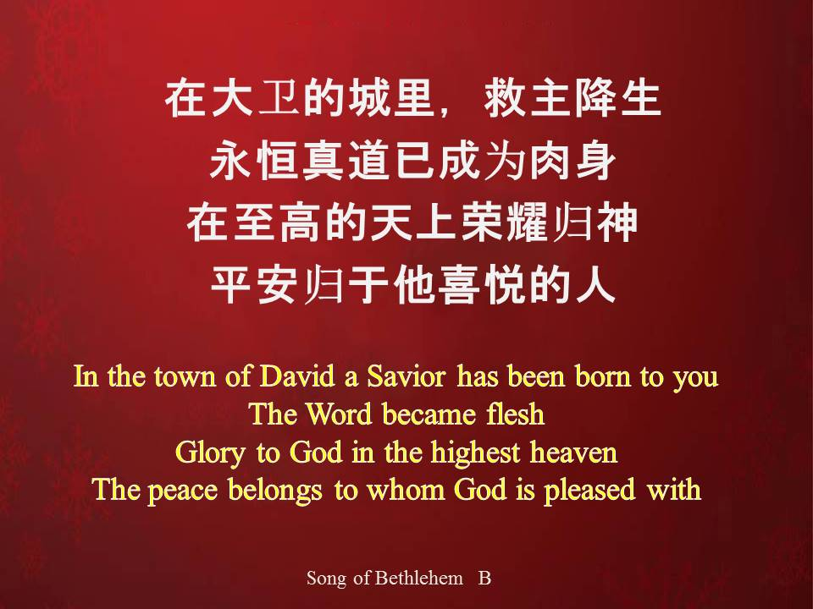
在大卫的城里，救主降生
永恒真道已成为肉身
在至高的天上荣耀归神
平安归于他喜悦的人
In the town of David a Savior has been born to you
The Word became flesh
Glory to God in the highest heaven
The peace belongs to whom God is pleased with
Song of Bethlehem B

Slide 4
宁静的伯利恒，平安的夜已深
郊外有一群牧羊人，一起叙寒温闪亮无数星辰，寂寞黑夜无声
蓦然有一群天使，宣告好消息
Silent Bethlehem, peaceful night there was a group of
shepherds living out in the fields chatting in the cold
Suddenly a group of the heavenly hosts appeared
and declared good news
Song of Bethlehem 1A

Slide 5
在大卫的城里，救主降生
永恒真道已成为肉身
在至高的天上荣耀归神
平安归于他喜悦的人
In the town of David a Savior has been born to you
The Word became flesh
Glory to God in the highest heaven
The peace belongs to whom God is pleased with
Song of Bethlehem B

Slide 6
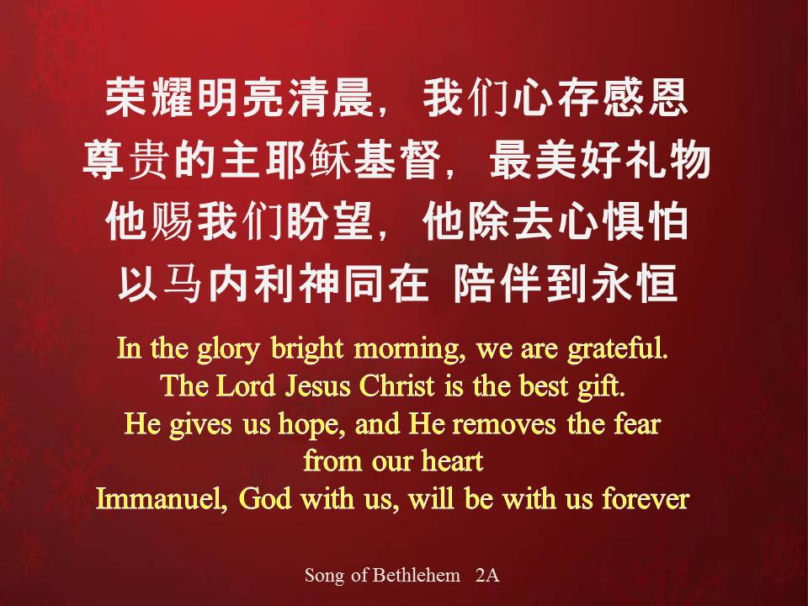
荣耀明亮清晨，我们心存感恩
尊贵的主耶稣基督，最美好礼物
他赐我们盼望，他除去心惧怕
以马内利神同在 陪伴到永恒
In the glory bright morning, we are grateful.
The Lord Jesus Christ is the best gift.
He gives us hope, and He removes the fear
from our heart
Immanuel, God with us, will be with us forever
Song of Bethlehem 2A

Slide 7
在大卫的城里，救主降生
永恒真道已成为肉身
在至高的天上荣耀归神
平安归于他喜悦的人
In the town of David a Savior has been born to you
The Word became flesh
Glory to God in the highest heaven
The peace belongs to whom God is pleased with
Song of Bethlehem B

Slide 8
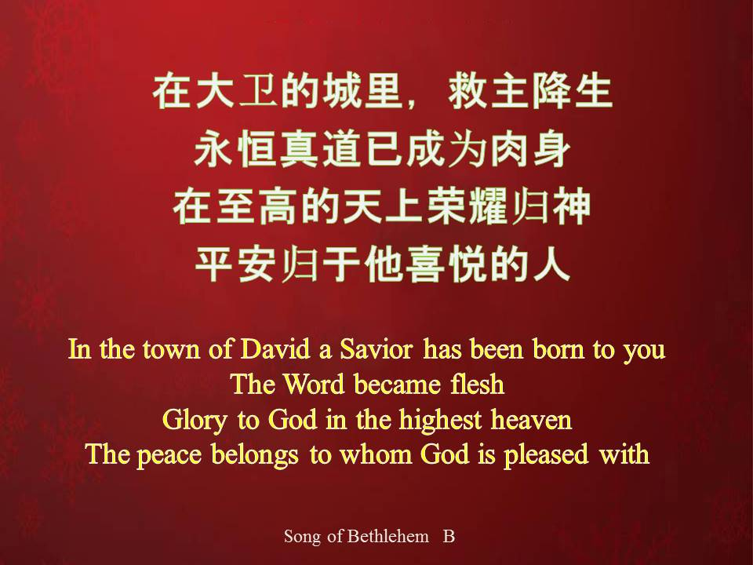
在大卫的城里，救主降生
永恒真道已成为肉身
在至高的天上荣耀归神
平安归于他喜悦的人
In the town of David a Savior has been born to you
The Word became flesh
Glory to God in the highest heaven
The peace belongs to whom God is pleased with
Song of Bethlehem B

Slide 9
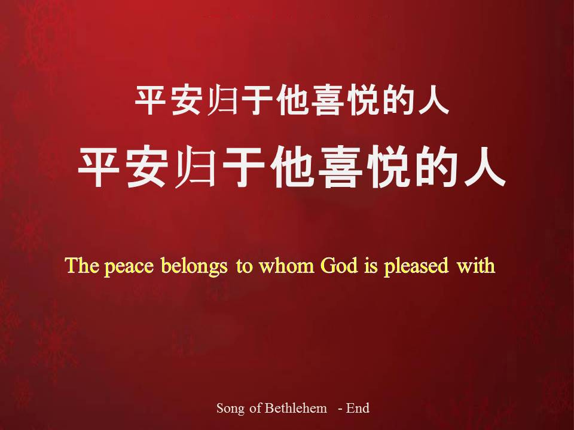
平安归于他喜悦的人
平安归于他喜悦的人
The peace belongs to whom God is pleased with
Song of Bethlehem - End

